Slide 1


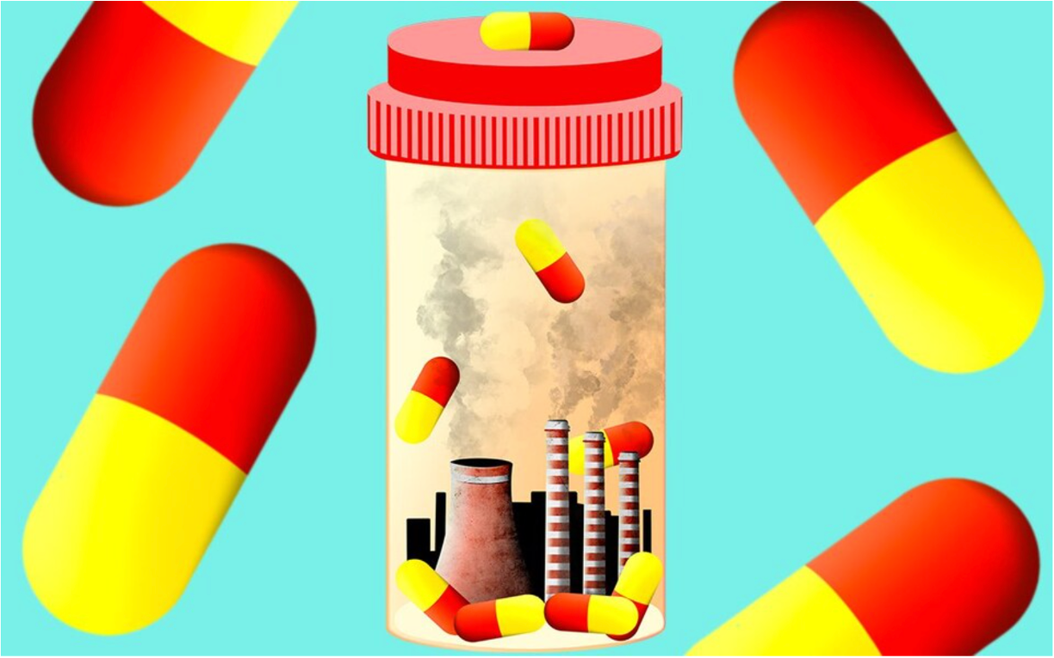
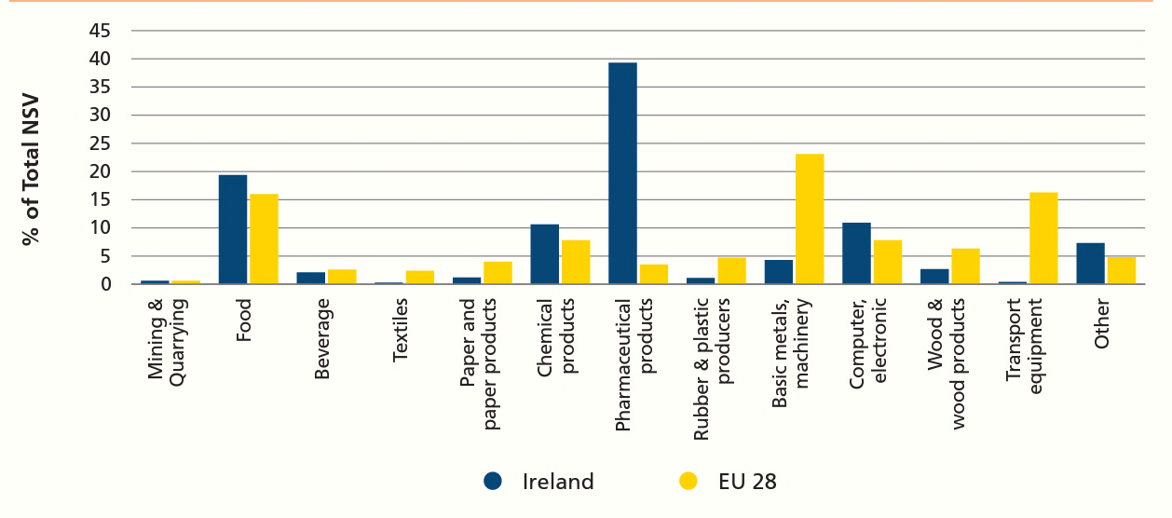
Carbon Emissions In Ireland's Biopharmaceutical Industry
Author: Áine Gallagher
Summary
Conceptual Framework
Results and Findings
The biopharmaceutical drug production process is extremely energy intensive and requires considerable amounts of electricity to maintain Good Manufacturing Practice and regulatory requirements, resulting in considerable carbon emissions. Many challenges face carbon emission reduction incentives in the Irish biopharmaceutical industry, primarily owing to the stringent regulatory environment. The main research study objective was to investigate these challenges in the Irish biopharmaceutical/pharmaceutical industry.
Research into the carbon footprint and emissions of the Irish bio-pharmaceutical industry was limited in the studied literature. Thereafter it was decided upon to conduct a research project investigating the challenges, and methods in place for emission reduction in the Irish biopharmaceutical industry, to fill this research gap. The conceptual framework is detailed below.
The Irish biopharmaceutical industry is performing reasonably well regarding carbon emission reduction, albeit on a slower scale when compared to other industries.
The main method of reducing emissions was purchasing of renewable energy. This practice offsets the carbon produced in biopharmaceutical drug manufacturing on Irish sites, yet the industry is hindered by EirGrid capacity issues.
Replacement of inefficient oil boilers with electric boilers to supply the high electricity and energy demands in drug production was noted as a common emission reduction method also.
Primary research reiterated the challenge regarding the regulatory environment. According to one interviewee:
“the greatest challenge we have in changing anything that we is that we're very regulated (. . .) When you're designing a process, you've great opportunity to make it efficient. That's largely lost in a GMP environment.”
The regulatory environment hinders sustainable changes within the industry, and whilst this can be perceived as a negative aspect, safe efficacious drugs is the end goal of drug production. Herein lies the conflict to sustainability in the biopharmaceutical industry.
Funding is a big barrier to carbon emission reduction, “corporate will” was also seen as a challenge to effective carbon emission reduction policies. Whilst not all primary research respondent companies have pledged to meet the milestones of the Irish Climate Act 2021, most participants had a semblance of policy towards meeting the Irish Climate Act goals.
Figure 1: Emissions from biopharma drug production ¹
High carbon emissions global pharma²
Inherent nature of Biopharma production
Energy intensive
Challenges: Climate Act 2021
HVAC and cleanroom requirements
Renewable energy challenges
Lack of funding &
governmental support
Employee interest
Benefits to reduction
Staff retention + interest in corporate sustainability
Background
Ireland has established itself as a prominent biopharmaceutical hub. The (bio)pharmaceutical industry in Ireland is the third largest exporter of pharmaceuticals worldwide, due to tax incentives (12.5% corporation tax and 25% Research & Development tax credit) and Governmental funding such as Science Foundation Ireland grants.
The Irish pharmaceutical sector had a Net Selling Value (NSV) of 39%, compared to 3.5% in the pharmaceutical sector of all other EU countries in 2018, highlighting the industry's prominence in Ireland when compared to other EU countries⁴ (figure 2).
Figure 5: Conceptual framework
Introduction
Figure 2: NSV Ireland versus European Union ⁴
Methodology
Biopharmaceutical drugs demand sterility in production, requiring intensive Heating Ventilation Air Conditioning (HVAC) and electricity requirements, and emitting considerable greenhouse gas emissions. Belkhir and Elmegli, (2019)² landmark paper first revealed the extent of pharmaceutical carbon emissions, summarised in figure 3.
Research significance:
It is “now or never” to limit global warming to “well below 2” aiming to reach no higher than 1.5 degrees Celsius by 2050, under the Paris Agreement ^{3.}
The Irish government introduced the Irish Climate Act 2021 and Climate Action Plan (CAP) (table 1) to counteract the climate change crisis.
This will be a difficult feat for biopharma, as emissions from the Irish pharmachem sector increased by 3% in 2021 compared to 2020 ⁵.
Research aim:
The research intended to study the challenges to carbon emission reduction within the Irish biopharmaceutical industry.
Purpose:
Exploratory
Design:
Sequential Mixed Methodology
Quantitative
Qualitative
Rationale: Complementarity
Purposive & Snowballing Sampling
Purposive
Sampling
Thematic Content Analysis and Excel Analysis
Thematic Content Analysis
Mixed Methodology
Pragmatism
Conclusions
Mixed methodology was chosen for this study. Amalgamating the detailed and in-depth opinions and insights from biopharmaceutical industry experts in qualitative interviews, with the broad and generalisable quantitative data, combined the strengths of both methods, thus, discounting the potential shortcomings of each strategy used alone.
Qualitative interviews were conducted prior to distribution of the quantitative survey, thereby allowing knowledge gained from the interviews to guide the survey questions. The sequential mixed methodology design was employed.
The Irish biopharmaceutical industry can only do so much to lessen carbon emissions themselves, the onus should be on the government to provide infrastructure and support such as towards EirGrid de-carbonisation to reduce Irelands biopharma carbon emissions. Providing support to industry is in the best interest of the government as it will help lessen Irelands carbon footprint, and repair Irelands damaged reputation as a large carbon emitter, whilst meeting international (Paris Agreement) and national (Irish Climate Act 2021) goals.
Belkhir and Elmegli, (2019)₂
Global pharmaeutical industry
Comprises: 4.4% of global carbon emissions
Emits: 55% more carbon than automotive industry
Yet, 13% more polluting
Pharma: 28% smaller than automotive industry
Recommendations
Goal | Year to be reached
51% reduction in Greenhouse Gas emissions (GHG) | 2030
Net zero emissions | 2050
Performing this mixed methodology study again in seven years’ time, with the the same interview and survey questions is a recommendation for the future.
The first deadline of the Irish Climate Act (figure 4) and the Paris Agreement³ will be approaching: 2030. Conducting this study, will evaluate if the carbon emission reduction incentives uncovered in the primary research were implemented and if carbon emission policies have improved since 2022.
References
¹https://www.telegraph.co.uk/health-fitness/body/dirty-business-medicines-carbon-footprint-can-do/
² Belkhir, L. and Elmeligi, A. (2019) ‘Carbon Footprint of the Global Pharmaceutical Industry and Relative Impact of Its Major Players’. Journal of Cleaner Production, 214, pp. 185–194. DOI: 10.1016/j.jclepro.2018.11.204.
³ UNFCC. (2015) The Paris Agreement | UNFCCC. Available at: https://unfccc.int/process-and-meetings/the-paris-agreement/the-paris-agreement
⁴ EPA. (2020) ‘EPA-Ireland’s-Environment-2020-Chapter10.Pdf’. Available at: https://www.epa.ie/publications/monitoring--assessment/assessment/state-of-the-environment/EPA-Ireland's-Environment-2020-Chapter10.pdf
⁵ EPA. (2022) News Releases 2022 (2). Available at: https://www.epa.ie/news-releases/news-releases-2022/epa-greenhouse-gas-emissions-projections-highlight-the-need-for-urgent-implementation-of-climate-plans-and-policies-.php (Accessed: 6 June 2022).
Figure 6: Research Design
Figure 3: Belkhir and Elmegli, (2019) synopsized
Table 1: Irish Climate Action Plan 2021

